Slide 1
RefuNet teaching resource pack
Our top tips
Check out this helpful video for teaching using Zoom
Our top three resource recommendations:
British Council
SQA (not the easiest website to navigate but the resources are good)
BBC
What’s included in this pack
Section 1: Lots of links to free resources, divided by theme
Section 2: Advice for teaching online
Section 3: Tips for teaching beginners and young learners
Section 4: Teaching students who only have a phone
Section 5: A list of organisations you can refer your student to if they need help with other issues
Section 6: A guide to English levels
Section 7: Example lesson plans for grammar, reading, listening and speaking lessons

Slide 2
Section 1:
Resources
General
British Council resources split by level and skill
BBC resources for every skill and level that students can use themselves or you can work through together
BBC videos teaching a range of skills (e.g. grammar, pronunciation, vocabulary):
Syllabus/lesson plan resources
Practical resources and lesson plans for primary, secondary and adult learners provided by the British Council. A good start for inspiration.
Lesson plans categorized by Beginner, Elementary, Intermediate, Upper Intermediate, Advanced.
Reading resources
Reading passages adapted to English learners, beginner – intermediate (A1 – B2): Topical news articles categorized by level
Video/audio resources
Listening lessons by level
British Council podcasts
More podcasts
Video and audio clips on a variety of different topics suited to different levels
A daily 15-minute radio programme, recorded in clear English
Speaking resources
Pronunciation lessons
Ted Talks can provide a good starting point for discussion for advanced learners
Teaching beginners/ low level learners
Great resource for teaching adults with no or low levels of English, providing a syllabus of lesson plans and teaching resources
This website also provides lesson plans for teaching beginners, although they will need to be adapted to the one-to-one online setting
See also here, here and here.
Teaching grammar
Explanations of grammatical concepts
Pre-made worksheets, good for practicing specific grammar concepts
For teaching grammar to beginners:
A grammar book for teachers
Places to look for free worksheets on various topics
https://en.islcollective.com/
https://www.tefl.net/esl-worksheets/
https://www.tefl.net/esl-lesson-plans/
http://www.onestopenglish.com/skills
https://busyteacher.org/

Slide 3
Preparing students for the IELTS exam
Official IELTS site explaining the test and providing sample marked tests
Comprehensive website with sample answers
IELTS resources for each skill
IELTS Vocabulary
Listening tests with answers and transcripts
Reading tests with answers
IELTS practice tasks
More practice exercises
IELTS tutorials and mock tests
IELTS lesson plans for each skill
Other exam resources
This website has lesson plans, teacher guides and advice on various exams
This website has resources for preparing students for Functional Skills exams:
A free course to prepare for the PTE exam
Functional skills resources
One practice functional English test
Medical English / OET prep
Information about the OET exam and some resources
Practice audio activity with tasks
List of resources and links for improving medical vocabulary
A free course students can access:
Resources for students to use in their own time
Future Learn free courses at elementary and pre-intermediate level
Games for learners to do as homework/in their free time:
Lessons on different topics across levels to help practise speaking, listening, reading and writing skills.
Free online course for beginners
Free video lessons from the BBC
Free English video lessons
Grammar and vocab quizzeshttp://a4esl.org/
Free English courses at various levels:
Resources for teaching children
British Council resources for primary and secondary level:
https://learnenglishkids.britishcouncil.org/
https://www.teachingenglish.org.uk/resources/primary
https://www.teachingenglish.org.uk/resources/secondary
Free audio books
Speak with Jack is an interactive platform for beginner and elementary-level students aged around 9-12. You can do a free trial and if you like it contact us as we can possibly get a free licence and definitely 50% off.
Games
Kahoot (for quizzes)
Fun site for improving vocabulary:
A game to practise phonics:
UK culture
Lesson plans on British culture
Life in the UK lessons plans

Slide 4
Section 2:
Teaching online
You are welcome to use any platform that you prefer for teaching. Here are some guides for teaching with Zoom and Google Meet.
Zoom
A helpful video explanation of how to use Zoom for teaching - https://www.youtube.com/watch?v=Z2UoOTg8J2I
Zoom now has a 40-minute limit for free 2-person classes. However, if you both leave the meeting just before the meeting ends, you can re-join using the same link. Alternatively, you can share a new link after 40 minutes.
The next page has some shortcuts you can use when teaching with Zoom.
Google Meet
In Google Meet, you can do 60-minute meetings for free, as long as you have a Google account.
This video guide is helpful - https://www.youtube.com/watch?v=8CjJ-7BO2qA
Note:
The first method of creating a meeting they talk through is not relevant
We would recommend the second method, but instead of clicking “new meeting” > “start an instant meeting”, you can click “new meeting” > “create a meeting for later”
They go through things very quickly, but you can slow down the playback speed if you want! You also likely won’t need all the detail they talk through.

Slide 5
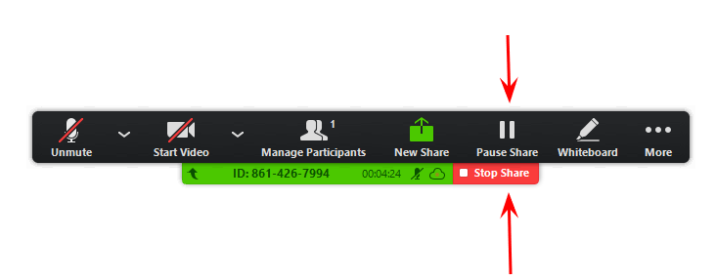
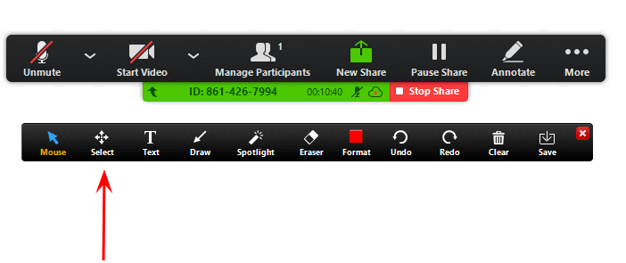
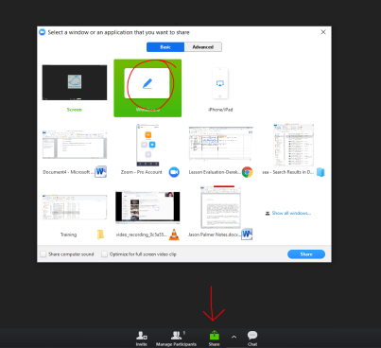
Zoom shortcuts
Ctrl/Command + Z = Undo annotation
Ctrl/Command+ Y = Redo annotation
Right-click mouse = Activates cursor (allows you access files without closing tool bar)
Double-click inside an annotated shape = activates “Text” function
Pause Share = Allows you to freeze the current image on the screen and use other programs, without the students being able to see what you are doing.
F3-F7 = Change through the Draw menu of the annotation bar
F9/Alt+S = Unfreezes your screen
Select Tool = Allows you to move any annotation mark by “clicking” on it with your mouse
Whiteboard = Allows you to annotate and keep the annotation marks there for the duration of the lesson. You can switch between “screen” and “whiteboard” by pressing the “New Share” button.

Slide 6
Section 3:
Tips for teaching different kinds of learners
Tips for teaching beginners
General
Keep instructions clear and simple.
Establish classroom language early on (“slow down, do you understand? repeat please?, how do you say? can you write that? try again?”)
When you are learning a new language, there is a lot to learn so try to revise previous topics each lesson. Teaching beginners relies on a lot of repetition and drilling.
Don’t be afraid to use Wordreference (like Google translate, but it puts words in context) or similar translation tools to work out a word in the student’s native language if possible. Trying to explain the word in English first and then then using a translator if they don’t understand or to check that they did understand can work best.
Show enthusiasm and give lots of positive reinforcements!
Vocabulary
Let them listen first. Over pronounce so students can see the shape of the words.
Start with learning word groups that you can easily use pictures for – eg food, places in town, colours, family trees. You can do various activities with each word group to help your student remember them – e.g. hangman, unscrambling the letters in the word, matching exercises etc. Have a look for free worksheets on the Internet as well.
When you introduce a word group, gradually introduce basic sentences, using actions, expression and images. For example, if you are teaching food, ‘I like’ can be introduced with a smiley face and the opposite for ‘I don’t like’. 2 faces can be used to show ‘really like’ and 3 faces for ‘love’. ‘My favourite’ can be introduced be saying it is your ‘number 1 food’, which is easier to understand. Verbs can often be introduced with actions – walking, listening, talking etc. can be shown through hand actions.
Basic vocabulary will build up very quickly and so can be used in subsequent lessons. For example, ‘I like’ can be used to have conversations about multiple topics.
It is amazing how much can be implied. For example, it is often easy to get across that a list of 7 words is the days of the week. Once you have done the days of the week, it is then easy to progress to months and the student will likely be able to follow easily. You can then introduce the concept of birthdays through very simple language, accompanied by hand actions to show present and future. eg ‘I am 22. In August, I will be 23.’ If the student knows your name they will be able to infer the meaning of ‘My name is xxx’. If you say ‘I live in London’ the student will have a good idea of what you mean (as long as you use a well-known place!)

Slide 7
Tips for teaching beginners cont.
Hand gestures are very helpful e.g. to show my/me, you/your, he/him etc. I often hold my fingers up close together to remind my student that they are missing a small word (to, of, the, a etc.). The first couple of times you do it the student may not understand but they should pick up what you mean. It’s obviously important to be consistent with the hand signals you use!
Use tone to express meaning – if you say ‘well done’ in a positive voice every time a student answers a question correctly they will soon pick up what it means.
When you are introducing questions (e.g. what is your name, how old are you, where do you live etc.), ask the question, then answer it yourself as an example, and then allow the student to try. Then write down the question and the correct answer and encourage them to copy it down.
Tips for teaching young learners
See the resources above for resources for teaching children / young learners and for games.
Finding out early on what their interests are and tailor lessons and activities around this can help keep them engaged.
Incorporating fun activities such as music, games and worksheets with pictures is also important.
You may find young learners can’t concentrate for a full hour, in which case it’s fine to do shorter sessions.

Slide 8
Section 4:
Tips for teaching students who only have a phone
General
It is often the case when teaching refugees and asylum seekers that they do not have access to many resources and may not have a computer or tablet to do the lessons. In these cases, many students use their mobiles. This can be difficult and at times, frustrating for the teacher. At RefuNet we understand that it is not an ideal situation to teach a student on a mobile but in these cases, we ask the teacher to make the best of it – the students (and we) are very grateful for your efforts!
First contact
It’s important to ask the student what device they will be using. At RefuNet we try to pass on this information if the learner informs us of this, but it is better for the teacher to confirm when first contacting the student. When sending the first email, ask the student to confirm. Tell them that if they have a laptop or tablet, then this is the preferred device for their lessons.
Set some guidelines
If the student informs you that they will be using a mobile phone for the lessons, then establish that they will need to find a quiet place and try to set the phone down so that they can be seen on video and not moving around.
Poor internet
It might be the case that the student is not using WIFI and is using their phone internet, which might produce connection issues. If the student’s connection is not good, you can ask them to turn off their video. It is of course always better to have the video on for both but if the connection dips, this might help improve connectivity. Google Meet also requires lower bandwidth than Zoom so you can try that. There’s a video on teaching using Google Meet here.

Slide 9
Pre class activities
If the student is on a phone for the lesson, then it might be difficult for them to read any texts you are using in class. If you are planning on working with any reading texts, send it to them before the class to read. You can also send them any activities (e.g. grammar) that would be better for them to do themselves rather than share on the screen.
Utilise the chat
It’s a good idea to also use the chat feature for any feedback and notes so that the learner has access to these after the lesson. You might even find it easier to videocall the student on WhatsApp to have a conversation class, if you are comfortable sharing your phone number.
Keep things simple
If your student doesn’t have time or want to do any pre-reading before class, then keep the lessons to simply conversation (if they are learning General English). This will allow them to get the best out of the classes and still learn something, but will be easier on the teacher’s side for delivering the lessons.
Have patience
It can be incredibly frustrating teaching a student who is not using a bigger device and your teaching can be somewhat restrictive. All we can ask if that you do your best and try to adapt your lessons. The learners will be happy to have any exposure to English and learn!

Slide 10
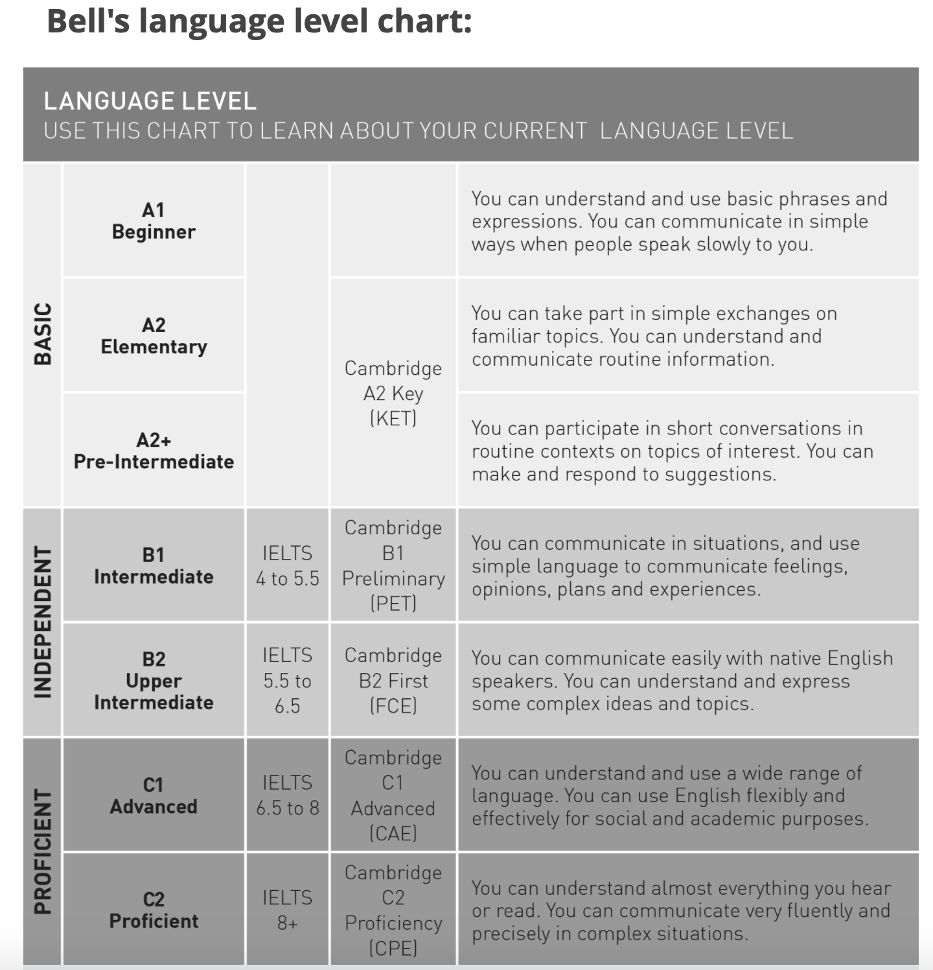
Section 5:
A guide to language levels

Slide 11
Section 6:
Signposting to other organisations
If your student talks to you about issues they are facing outside their lessons and you want to help, you could help them contact an organisation who can support them. Here’s some examples of organisations that work with refugees in different areas. If you want to find a local organisation, a quick Google often gives some good results. And any questions / doubts, please don’t hesitate to reach out to us.
Employment support
Breaking Barriers
RefuAid
Refugee Council
Starting a business
The Entrepreneurial Refugee Network
University scholarships
Student Action for Refugees
Lawyers
Care4Calais (Currently only providing lawyers for people who have arrived in the UK by lorry or boat since 28th June 2022)
Mental health
Barnado’s helpline for asylum seekers
Refugee Council
The NHS website can signpost you to local services
Challenges with accommodation
Migrant Help (please contact Bethany at contact@refunet.co.uk for advice on this)
ACH Housing – housing for refugees in Birmingham, Bristol, Coventry and Wolverhampton

Slide 12
More practice speaking English
SPEAK – online conversation practice
A local City of Sanctuary group
Otherwise, you can try Googling the name of the town, English practice and refugees and normally something will come up.
Other things
Please feel free to reach out to Bethany at contact@refunet.co.uk with any other suggestions.
Something we’re missing from this list?
Please let us know!

Slide 13
Section 7:
Lesson planning
Tips for lesson planning.
Have a rough plan for the lesson to provide some structure
Pick something to focus on for each lesson. This could be a grammar concept, a speaking activity, a role play scenario etc.
To make lessons more engaging, try to tailor activities to the interests/hobbies of the student
Encourage the student to identify any tricky points that come up in their own learning and to raise these with you. These grammar/vocabulary/pronunciation points can then be used as the basis for future lessons
Don’t spend too long planning/preparing resources! You do not have to come up with the most creative activities, and there is plenty of material online
Different lesson ideas.
Teaching specific vocabulary sets (food, holiday, professions, celebrations, objects the house)
Grammar lessons
Reading passage with questions
Audio with questions
Role play scenarios (making an appointment, at the supermarket, job interview)
Speaking activities (Debates, surveys)
Written activities (formal letters, emails, postcards, diary entries)
Games (Pictionary, 20 questions, two truths and a lie, who am I?)
Level appropriate topics.
The internet is an excellent resource for finding level appropriate topics. The resource list at the end of this booklet provides some links to websites with lesson plans tailored to different learning levels/ages, and this is a great starting point.
Inspiration:
Beginner – Introductions, getting to know you, hobbies, family/pets, animals, food and drink, likes and dislikes, hobbies, telling the time, numbers and the alphabet, daily routine, clothing, physical description
Intermediate → Advanced – Cultural differences, living abroad, festivals, music, technology, health, relationships, multiculturalism, environment, topics in the news, future dreams, past experiences

Slide 14
Outline of a grammar lesson
Before lesson
Prepare a PowerPoint on the grammar concept you are going to teach. No need to make this fancy – just an outline of the basic rules for its use, how it is formulated and if there are any exceptions to the rule. This can be taught live through the share screen option on Zoom or sent in advance and spoken through live in the lesson.
Prepare/find an activity sheet to practise this grammar concept, to be used during the lesson. It is a good idea to include a few different activities on this sheet, especially if you are teaching a fast learner or if the grammar concept is complex.
Optional: Prepare a short homework activity on the grammar concept
During the lesson
Warm up/initial chat
Informal chat; challenge the learner by asking questions provoking different tenses (”What did you do this morning, what are your plans for tonight”)
Quick review of any vocab/grammar points from previous lessons. Also an opportunity to give feedback on homework.
Introduction
Describe the grammar concept you will be teaching (“Today I want to tell you about the tense X that we use for X”)
Include some real-life examples to contextualise the grammar. This will help the student to identify situations when it would be used.
Presentation – don’t spend too long on this as the learning happens through practice!
Present the grammar using the PowerPoint so the student can follow along
Ask the student if they understand and go through a few practice examples with student to check their comprehension.
Practice activity
Work through the the activity sheet together - have the students read out the instructions for each activity and complete sentences in full (to practise pronunciation).
Listen out for any mistakes that the student makes. If the mistakes are significant or repeated, then they can be used as a basis for a future lesson.
End of lesson / Homework
Quick recap of grammar concept, using examples and soliciting answers from student
Ask if they would like further practice on the topic in another lesson
If requested provide homework. This could be finishing off the in-class activity sheet or providing an additional practice sheet.

Slide 15
Example grammar lesson: The present continuous
PowerPoint presentation slide:
Activity sheet to do in class:

Slide 16
Example grammar lesson: Possessive pronouns
PowerPoint presentation slide:
Activity sheet to do in class:

Slide 17
Outline of a reading lesson
Before the lesson
Find/write a reading passage that is suitable for the level of the student. It is a good idea to pick a reading on a specific topic to help build a new vocabulary set
Make the text readable for the learner by dividing it into paragraphs and adding some pictures. Identify key vocabulary in the text in bold.
Prepare some questions based on the reading. Tip: include questions where the learner is required to do more than lift their answers from the text e.g. True or False questions
* For beginners, it can be helpful to send the reading in advance and have them complete the questions before the lesson. This gives lower level students the opportunity to translate new vocabulary and the necessary time to develop comprehension of the text. The activity can then be worked through together during the lesson
During the lesson
Warm up/initial chat
Informal chat; to challenge the learner ask questions provoking different tenses (”What did you do this morning, what are your plans for tonight”)
Quick review of any vocab/grammar points from previous lessons. Also an opportunity to give feedback on homework
Introduction of the text
Introduce the text (either the student has been sent this in advance or through the shared screen function on zoom) and ask the student to read the text out loud to practise pronunciation
When they have finished check their comprehension of the text and go through the key vocabulary in bold. Ask if there is any additional vocabulary that is new and go over any pronunciation issues
The question sheet
Move on to the questions, having the student read the question out loud and respond verbally with their answer
Encourage the student to answer the question on their own, even if this takes time. If they are struggling, prompt them to the paragraph containing the answer
If the student moves through the questions quickly, use the text as a prompt for further conversation. For lower level students you could ask more general questions based around the topic of the reading. For higher level students you could ask questions directly related to the reading such as whether they agree/disagree with the opinion expressed, what more they know about the topic etc.
End of lesson/ Homework
Quick recap of new vocabulary and pronunciation issues that have come up
If requested, provide a homework practice activity/sheet

Slide 18
Reading samples
Example: Beginner (A1)
Me
“My name is Anna. I came to Britain 5 years ago. I am 33. I am from Germany. I am a singer. In the evening I sing at a club. I have a garden where I grow flowers. In summer they look beautiful. I also grow vegetables and I use them when I am cooking. I work in my garden to relax.”
Example: Intermediate (B1)
The Empire State Building
When exploring New York City, there are several different options for activities during a day trip. Some visitors come to see a show, visit art museums, or simply to shop in many of the city’s high-end retailers. However, many tourists simply come to New York City for the sightseeing. One of the most visited landmarks in New York City is the Empire State Building. The Empire State Building, constructed in 1931, is a 102-story skyscraper, the ninth highest building in the world, and the fourth tallest structure in the United States. It is located in Midtown, Manhattan. This skyscraper is an iconic symbol of the city, having been featured in over 90 popular movies (as of 2018) throughout film history. Tourists come from all over the world to visit this building and view the city from its famous observation decks……
Example: Upper intermediate – Advanced
From: Jo Backhouse
To: Karl Anderson
Date: 17 October
Subject: Support for Judy
Dear Karl,
I received a call from Judy a couple of days ago to discuss some of the issues that she was having and I thought I'd give you a heads-up on what was said, seeing that you are Judy's project team leader.
Judy really enjoys working with you and the team and finds the project very interesting, but I think she's feeling a bit lost and struggling to see the big picture. It seems that she's been given a fair amount of autonomy to carry out the tasks that you've given her, and of course this level of delegation is not uncommon in your branch. But I believe in her Tokyo office, she is used to a bit more managerial direction and guidance and so is finding this international project quite daunting.
When I asked her about meeting her deadlines, she mentioned that due to the recent changes to the project timeline, her goalposts have been moved, and she doesn't seem to really understand why this has happened. Bearing in mind that she's also facing simultaneous deadlines from her department in Tokyo, we can presume that she might be feeling a bit stretched.
Looking ahead, I was wondering if we could make it easier for Judy by offering her more direction when setting her tasks, at least until she learns the ropes and gets used to working unsupervised. I think she'd also appreciate you giving her a clearer idea on how her role in the team fits into the overview of things….

Slide 19
Example reading lesson
Level: Elementary +
Topic: Professions
Susie the hairdresser
This is Susie, she is 35 years old and she lives in Manchester in the North of England. She works full time as a hairdresser in a hair salon in the city center. From Monday to Friday she starts work at 9am and finishes at 5pm. Susie lives close to the hair salon, and she walks to work everyday.
Susie is also the manager of the hair salon where she works. She employs a team of five other people. This job comes with a lot of responsibility, for example she has to make the work schedule and pay everyone’s salary at the end of the month. All of the staff at the hair salon get along well, and they think that Susie is a great boss.
Susie loves having a creative job. When she was younger she wanted to be an artist because she enjoyed painting and drawing classes at school. After she finished high school she went to college to get a hairdressing qualification and she has been working as a hairdresser for 15 years. She has worked at four different hair salons in Manchester. Susie is good at her job and she doesn’t think she will ever change her career.
Susie really enjoys her job because she makes people look and feel good. When customers leave the hair salon they are always smiling and they usually give her a tip.
Susie’s job also allows her to meet new people and chat to clients. It is a very sociable job and Susie prefers this to working behind a computer screen all day.
However, Susie doesn’t like the pressure of the job. Her work is very busy and she has to be on her feet all day long. She never gets to take a break and sit down! In the future she would like to go part time, but right now she needs the money.

Slide 20
Questions
What is Susie’s Job?
Where does Susie work?
How many days a week does Susie work?
How does Susie get to work?
Susie is the manager of the hair salon. True or false?
What responsibilities does Susie have at work?
Susie used to work as an artist. True or false?
For how long has Susie been working as a hairdresser?
Is Susie looking for a new job?
Give one reason why Susie likes her job.
Why does Susie feel tired at work?
What would Susie like to do in the future?
Activity (further questions for student)
Tell me about a job you had in the past. What was your favourite/least favourite thing about the job.
Have you ever worked part time? What are the advantages and disadvantages of working part time?
When you were growing up what did you want to be?
Provide a definition
Full time work →
Part time work →
Manager →
Responsibility →
Pressure →
Qualification →
Tip →

Slide 21
Outline of a video lesson
Video lessons are more suited to higher levels
Video lessons can be taught online using an online platform with a share screen function, such as zoom.
Inspiration for video clips:
YouTube: Ted talks, tutorials, vlogs
Film / documentary clips, episodes of TV programs,
News clips / weather forecasts
Advertisements
Interviews
Songs
Before the lesson
Find a video clip that is suitable for the level of the student. If the video is too long, identify the part of the clip you want to show. It is a good idea to pick a video on a specific topic to help build a new vocabulary set.
Prepare a sheet with some questions based on the video (3-5) , and a relevant post-video speaking activity
During the lesson
Warm up/initial chat
Informal chat; to challenge the learner ask questions provoking different tenses (”What did you do this morning, what are your plans for tonight”)
Quick review of any vocab/grammar points from previous lessons. Also an opportunity to give feedback on homework.
Introducing the video
Introduce the video. Ask what the student thinks the video is going to be about based on the title, if it is a topic that interests them, what they already know about the topic etc.
Pre-teach some vocabulary from the video. Ask the student to listen out for this vocabulary when watching the video for the first time.
Tip: Each time the student watches the video give them a task to be doing, this helps to maintain their focus
Watching the video
Watch the video for the first time. Ask if the student identified the vocab. Introduce the questions and ask the student to listen out for the answers.
Watch the video for the second time. Ask if the student needs to listen to the video another time to get the answers to the questions.
Go through questions and answers together.
Activity
Move on to the post-video speaking activity
End of lesson / Homework
Quick recap of new vocabulary and pronunciation issues that have come up
If requested, provide a homework activity / sheet

Slide 22
Example video lesson
Level: Upper Intermediate
Topic: Technology
Video: TED talk “how to get your brain to focus” (until 3:00)
Accessed from youtube: https://www.youtube.com/watch?v=Hu4Yvq-g7_Y
Pre-teach vocabulary:
Screens -
Applications -
Distracting –
To waste time -
To get rid of -
To observe -
Attention span -
To focus -
Questions:
What observation did Chris make a few years ago?
Which device did Chris waste the most time on?
What experiment did Chris try?
What happened during the experiment? (3 things)
Post-video activity: Discussion on technology
What are the advantages of technology? What are the disadvantages of technology?
Has technology ruined our ability to focus?
Do you think you spend too much time on screens?

Slide 23
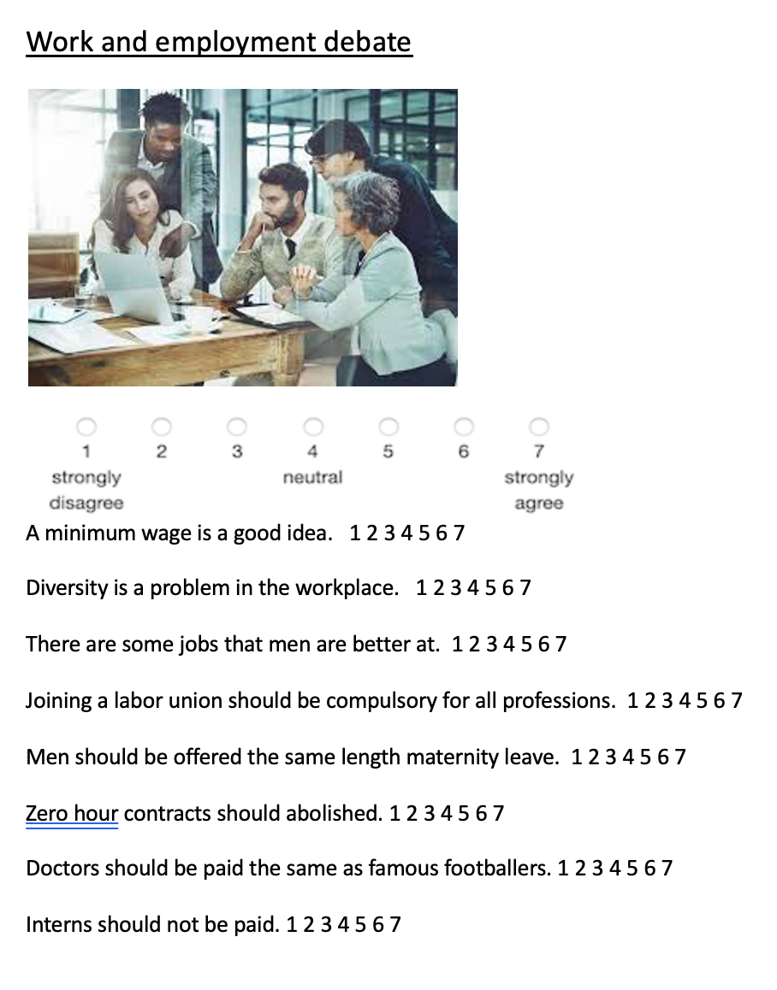
Speaking activities
Debates
Suited to intermediate+ levels
Topics: health, multiculturalism, family and relationships, technology, issue-specific such as freedom of speech
http://iteslj.org/questions/ has loads of pre-prepared questions for conversation practice on a variety of topics
Before the lesson pick a topic that can be debated over (suited to age level) and send the student a sheet in advance with some questions, which they have to rate a response to.
Debate in the lesson.
.
Invented situations.
Advice
Suited to intermediate+ levels
Examples: Choosing a candidate for a job position, giving advice to a friend on their problem, Pros/cons list
Create a real-life scenario/situation with different responses to be debated by the student
.
Your friend Amy wants to lead a healthier lifestyle, what 3 pieces of advice would you give her?

Slide 24
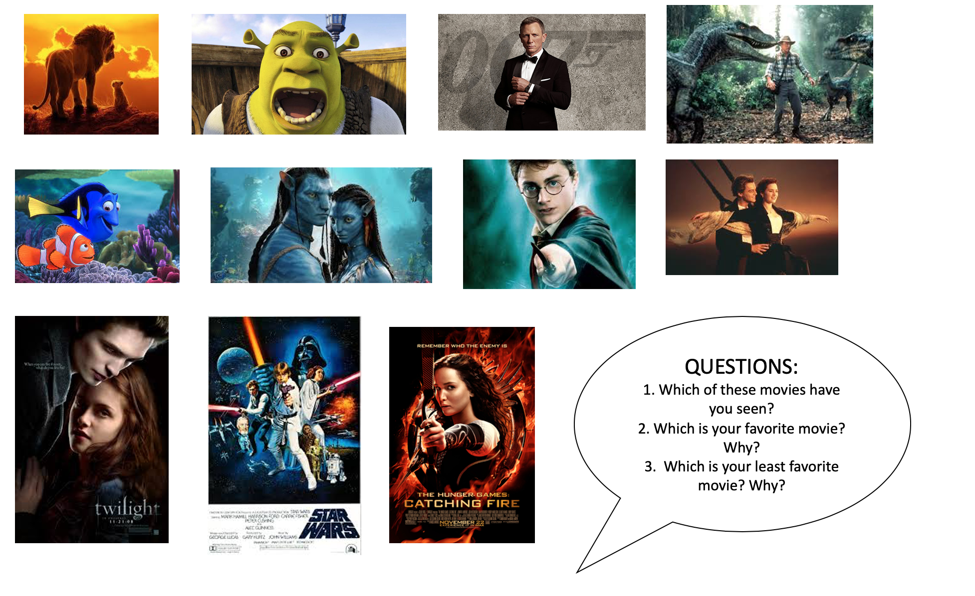
Questionnaires
Suitable for intermediate+ levels
Topics: Books, TV series, Musicals, games
Show and tell
Suitable for intermediate+ levels
Good for practicing the past tense
Ask the student to bring an object to the lesson and to describe the story behind it, what it means to them etc.
Role play activities
Suitable for intermediate+ levels
Good if the student is studying English for a specific purpose
Examples: making doctor/dentist/hairdresser appointment, serving customers, ordering a taxi, asking for directions, buying a train ticket
Example, job interview:
Help the student to craft some answers to the questions first, and then act out the role play together at the end of the lesson
Q) “Where did you study?” A) I graduated from ____ in ____.
Q) “What are your strengths?” A). One of my strengths is ____.
Q) “Why do you want this job?” A) I want this job because ____.
Example, buying a train ticket:
Find a YouTube clip of this situation being acted out
Transcribe the video and then have a fill in the blank activity prepared based on the transcript

Slide 25
Worksheet activities
Venn diagram
Good for comparing and contrasting
Tables
Good for sorting activities
Can be adapted to the interests of your learner
Odd one out
Good for teaching a specific vocabulary set
Filling in profiles/ forms
Think of real life situations where you are required to fill out information and use this as a basis for an activity
“Top 5”
Top 5 favorite games | Top 5 favorite game characters | Top 5 favorite games consoles
Animal categories
Land | Water | Air

